Slide 1
QuestionPeach A New World of Surveys
Class Project
CSCI 6442
George Washington University
Spring 2014

Slide 2
Agenda
Introduction to the Project—DCR
Data Model – Builder Team
Star Schema Model – Analyzer Team
Project Organization—System Engineering Team
Builder Team
Analyzer Team

Slide 3
Project Introduction
Goals
Use lessons of the course
Transaction Processing
Data Warehouse
Provide a work-like experience
20 people on one project, not just 3 or 4
Evolving requirements
A demanding customer
High quality UI requirements
Continual testing and evolution

Slide 4
Classroom Software Engineering
High level of communication to all participants
Class email list goes to all project participants
Used for project communications
Activities that are normally serialized can be done in parallel
Data modelling
Use case development
No time to build infrastructure
WordPress provides userids, Web infrastructure
Lots of public documentation, plugins help WordPress development

Slide 5
Generalized Data Model

Slide 6
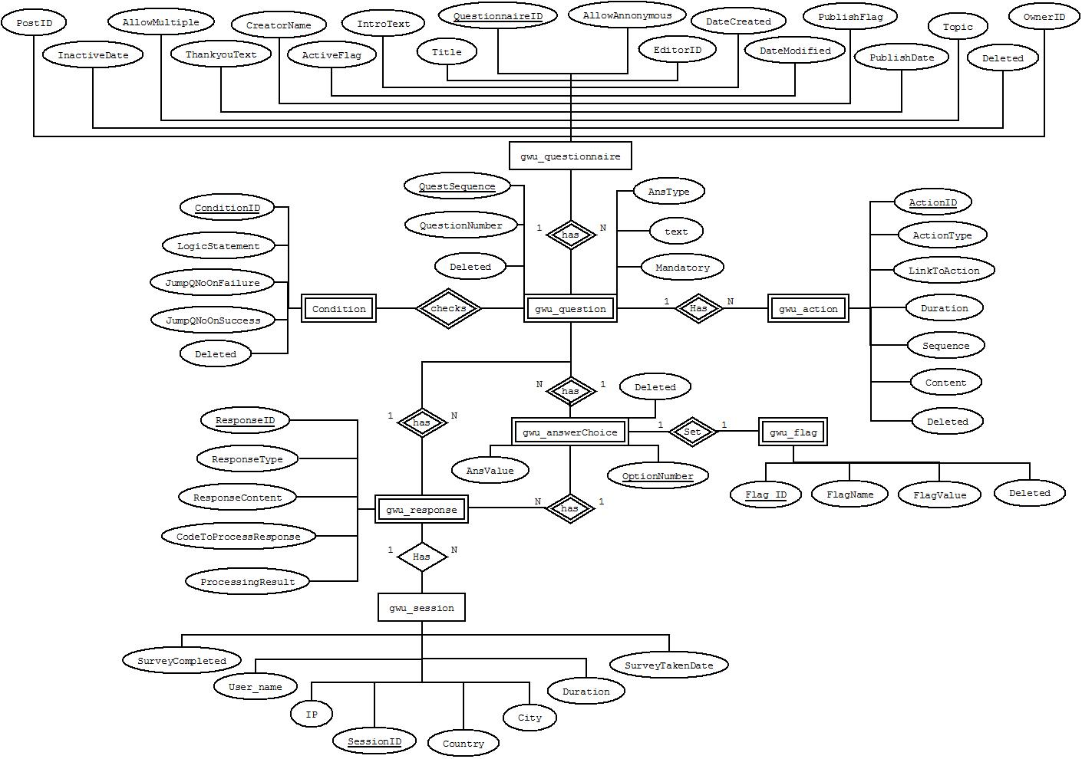
Data Model – Chen’s Model

Slide 7
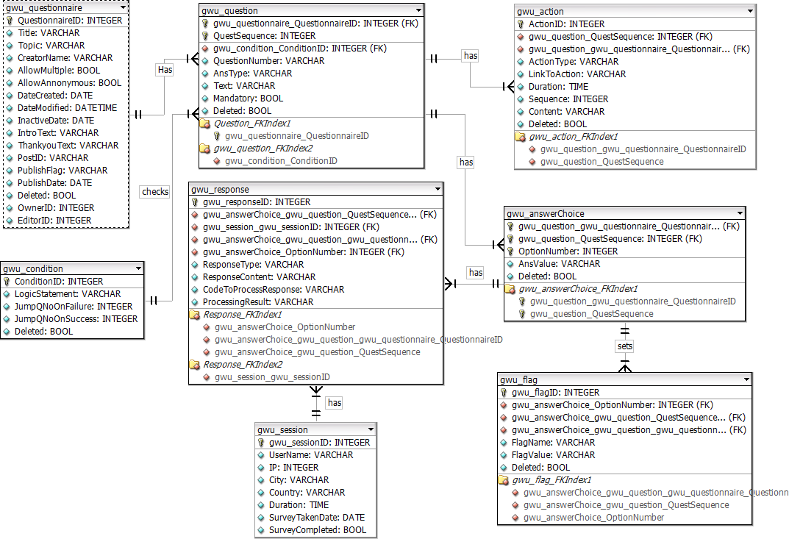
Data Model – Crow’s Foot

Slide 8
Normalization and Roberts’s Rules
Normalization:
1NF is followed – All attributes of the entity are atomic
2NF is followed – All the attributes are about the entity
3NF is followed – There are no transitive dependencies
4NF is followed – There are no multi-valued dependency
BCNF is followed – There are no overlapping candidate keys
Roberts’s Rules:
RR1 is followed – All attributes are about the entity
RR2 is followed – No repeated facts
RR3 is followed – Each tuple is present only once
RR4 is followed – No attributes have cardinality greater than 1

Slide 9
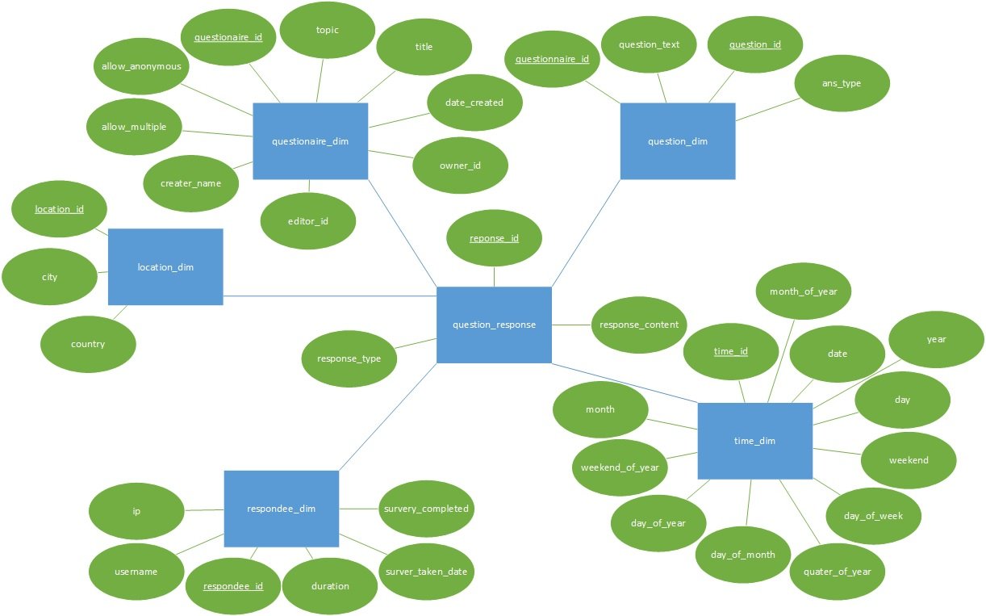
Star Schema Data Model – Chen’s Notation

Slide 10
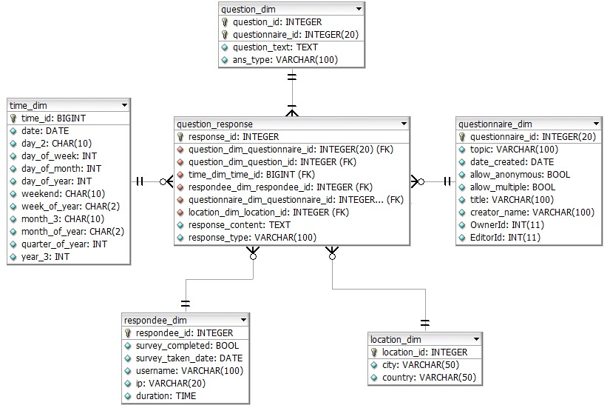
Star Schema Data Model – Crows Foot Notation

Slide 11
Project Organization
Three teams and roles of each
System Engineering Team: Direct the project technical efforts
Test and Confirm the designed project to meet customer requirements
Builder Team: A plugin for users to create, publish and distribute online surveys
Analyzer Team: A plugin for users to analyze the results of each survey
Independent testers and roles of each
Monisha&Iswarya
Testing of builder and analyzer plugin development
Unit testing
Integration testing

Slide 12
System Engineer Team
Feb 19 – Mar 25
Form the team
March 26 – April 12
Divide the responsibility
Ashley-Builder
March 26 – April 12
Weekly Meeting with professor to report the progress of the plugin development
Do the research for the WordPress and Plugin
April 12 – April 19
Create the role and capability of the plugin
April 19– April 29
Improve the role and capability
Create OwnerId and EditorId and save their relations to support the role filter implementation
May
Integrate Two plugins
Introduce WP
Chandan-Analyzer
Guide Team members to develop plugin and to use databases
Create the UI for owner to view editors
Give suggestions to both teams
Upload plugins to the test site

Slide 13
Builder Team
Responsibilities
Team Organization
Software organization

Slide 14
March 19 – March 25
Form teams
Choose team leader
March 26 – April 1
Improvised Data Model
Use cases.
April 2 – April 8
Questionnaire creation
Work on the data model.
Develop a plugin that:
Creates tables on installation.
Display tables on page.
April 9 – April 15
Lock the data model.
April 16 – April 29
Update data model to reflect roles.
Condition Creation
May
Testing and recovery.
Deletes tables on uninstallation.
Question creation
ORM
Response Page
Publishing the questionnaire
Flags Creation
Action display
Updated the plugin
Action Creation
Condition Evaluation
Multiple action support
Edit and delete functionality
Questionnaire duplication
Created new theme
Action upload feature

Slide 15
Software Organization
Survey Creation
Survey Taking
Display questionnaire
Record response
Evaluate condition
Action display
Question and question choice creation
Action creation
Flag creation
Logic and branching creation
ORM
Database

Slide 16
Builder Team
Individuals and Responsibilities

Slide 17
Builder Team – Mustafa Dasorwala
Responsibilities:
Dividing the tasks among team members
Discussing and resolving issues faced by team
Finalizing implementation logic
Worked on Data Model
Created the ORM
Implemented Action creation functionality
Created Questionnaire Duplication functionality
Implemented Condition Parser
Performed White Box Testing

Slide 18
Builder Team - Nada Alarfag
Worked on the Data model
Created Git repository for the builder plugin
Introduced classes to the plugin and functionalities decupling
Implemented:
Tables create and drop statements
Questionnaire related features:
Creation
Add a validation to the form
Editing
Deletion
Deactivating a published link and republishing
Viewing all questionnaires
Check current role and view accordingly
Extend WordPress list table
Use WordPress admin notice
Execution of published questionnaire
Create a template for executing published questionnaire
Hide the list of published questionnaires from the homepage

Slide 19
Builder Team- Nada Alarfag
Implemented (cont.):
Questions related features:
Adding new question
Creating the master PHP file for all types of questions
Add flags fields for multiple choice questions
Add a validation to the form
Use JQuery to add more input boxes for the answer choice
Shift questions’ sequences for question added between questions
Editing
Populate the correct form with current question data including the answer choices and flags
Deletion
Viewing all Questions
Add buttons that is displayed when hover over a question
Add the necessary hidden fields

Slide 20
Accomplishments – Darshan Pandhi
Data Model design
Worked on designing the data models for the Builder team
Started the Chen notation diagram
Use cases
Discussed with the use case team and came up with total 9 use cases
Reviewed the entire use case doc and presented to the entire team in class
ORM
Researched several open source ORM frameworks for Wordpress like Doctrine, Yi and Wp-ORM
Modified Wp-ORM and added several new features based on the requirements of the plugin
Created models to map all the tables in the database and made a Wrapper class which made it easy for others to interact with the database

Slide 21
Accomplishments – Darshan Pandhi
Conditions
Added the feature to define conditions for branching
Built and tested all the CRUD functionalities
Helped in
Session creation
Defining actions
Testing
General error debugging and solving
Team meetings and classroom discussions

Slide 22
Builder Team - Monisha
Responsibilities:
Make changes and maintain the data model
Manually populate data in the tables using SQL scripting
Change the corresponding plug-in depending on the changes in the data model
Testing of builder team development
Black-box testing
Unit testing
Integration testing

Slide 23
Builder team —— Kaihua Wu
Developed the Data model
Implemented:
Response.php(use to show questionnaire for user to take, and save their responses)
Session Part
Get the IP address and user login name, if the questionnaire do not allow anonymous, users without login will be declined.
Store the basic information in session and database, the session Id will be a foreign key to response.
Record the question sequence no in session, user can continue unfinised survey
Response save part.
If there are posted data from last question, response will be saved depending on the question type.
Branching part.
If there are associate condition of the question, it will be checked before the question.
Flag values will be computed from stored responses.
Flag values will be compared with condition’s logic statement like” ( f1 == 1 ) and ( f2 == 1 ) or ( f1 == 2 ) and ( f2 == 2 )”, the and will be computed before or. The next sequence number will depends on its Boolean value.

Slide 24
Builder team —— Kaihua Wu
Response.php(use to show questionnaire for user to take, and save their responses)
Show Action part
If the question has actions, read it from the database.
Arrange the actions group and order by sequence.
Use JavaScript to show the video and the Image in one sequence, provide button to jump to next sequence .
Show question part.
If the question is not mandatory, provide a checkbox for user to skip.
Create Html to show the question depending on its type, there are four types: NPS, Text Box, Multiple Value and Single Value.

Slide 25
Builder Team – Sachin Telalwar
Responsibilities:
Started with studying project and understanding already implemented application such as survey monkey etc
- Data Model :
Worked on Data Model
- Use case design :
Part of use case designing team
We came up with 9 test cases initially and I wrote 3 use cases and presented it.
- ORM :
I was part of ORM designing team.
Studied ORM like Doctrine, Yii and Wp-ORM. We used Wp-ORM and modified it accordingly our need
We created Wrapper class so that every developer can use ORM functionalities.
- Displaying questionnaire from URL :
Given a URL display all question according to their type.
- Saving responses :
Developed a logic to save all the responses given by user.
- Branching :
Get the flag values based on user responses.
Compare the flags with logic statement stored in database
Decide whether they match or not and depending on that display next question
- Unit testing

Slide 26
Builder Team – Ashley Zhu
Attended the Data model Meeting
Introduced the plugin to the class
Implemented:
Insert Query Function
Add the admin menu for the plugin
Questionnaire related features:
Creation
Tested and separated the save and cancel button
Publishing
Created the URL for each questionnaire
Created the dynamic short code to display the questionnaire

Slide 27
Builder Team – Neeraj Ughade
Responsibilities:
- Data Model :
Worked on the Chen’s Notation diagram of Data Model
- Use case design :
I was part of the Use Case designing team
we discussed and implemented 9 use cases
- User Interface :
I was part of the UI designing team.
I created the “Add New Questionnaire” page
Designed the UI for the flag creation and set condition
Worked on the UI for Action creation
- Performed Unit Testing

Slide 28
Builder Team – Tejasvi Sharma
Responsibilities
Worked on Data Model
Use Case Design:
Part of Use Case Design Team
Total 9 Use Cases , Created 2 Use Cases
Worked on ORM
SQL Scripting & Populating Data in Tables
Worked on UI for Action Creation.

Slide 29
Analyzer Team
Responsibilities
Team Organization
Software organization

Slide 30
Responsibilities
March 19 – March 25
Form teams
Choose team leader
March 26 – April 1
Star schema data model.
Use cases.
April 2 – April 8
A transfer code (data migration).
Cron job to transfer data.
Work on the data model.
Develop a plugin that:
Creates tables on installation.
Display tables on page.
Design a GUI query tool.
April 9 – April 15
Lock the data model.
A single plugin that does all the functionalities.
Produce analytical report.
Produce graphical results.
April 16 – April 29
Update data model to reflect roles.
Customized Reports using filters.
Net Score Promoters surveys.
May
Testing and recovery.
Deletes tables on uninstallation.

Slide 31
Team Organization
1st Phase
Team as a whole worked on data model.
2nd Phase
Use Cases.
3rd Phase
Database programmers.
Star Schema Data Model.
Plugin Development.
Plugin programmers.
Testers.
GUI designers.

Slide 32
Software Organization
Analyzer
GUI
View graphical results
Behind The Scene
Create tables
Data migration
Create filters
Cron job
Drop tables
Export reports as PDFs
Generate analytical reports based on filters

Slide 33
Analyzer Team
Individuals and Responsibilities

Slide 34
Individuals and Responsibilities
Iswarya Parupudi
Use cases
GUI Design
Harsh Shah
GUI design
Use cases
Yash Shah
Hrishikesh Sadar
Use cases
Cron job back up plan
Data model
Testing
Testing
GUI Map & Charts
GUI Map & Charts
Testing on Cron job
Testing on Cron job

Slide 35
Individuals and Responsibilities
Sonal Sonavane
Export to PDF
Ibou Diallo
Plugin creation
Kholood Alnowaiser
Team leader
Data model
Alemberhan Getahun
Plugin creation
Filters Implementation
Data migration
Filters Implementation
Cron job
GUI implementation
Filters Implementation
Data Migration

Slide 36
Kholood Alnowaiser
Team leader
Divide the job
Be there for other team members
Learn from mistakes!
Data model and star schema
Data migration functions for
First installation
Cron job
Refresh button
Data integration with builder’s tables
SQL scripts
Custom reports algorithm and UI design for filters

Slide 37
Alemberhan Getahun
Plugin Design and implementation
Develop the User Interface(UI) for Analyzer
Implement all the functionalities
Populating dimension tables values from the database
View All result
Save filter
Manage Filter
Refresh
Authorization and authentication
result presentation ( graph, pi-chart (NPS) and text)

Slide 38
Ibou Diallo
Plugin Design and implementation
Developed initial plugin utilities including data migration and cron job and UI utilities
Merge plugins
Implement the following functionalities
Scheduled Cron job for data migration
Data migration utilities (Create table, drop table, insert data functions, SQL scripts)
Save filter
Manage Filter
Data output presentation (NPS design)

Slide 39
Analyzer Team – Iswarya Parupudi
Responsibilities:
Developed a set of use cases for analysis of questionnaire results
Designed the GUI of the analyzer plug-in
Contributed in the GUI Code for implementing Google Charts and Geo Map
Testing of analyzer team development
Black box Testing
Unit testing
Integration testing

Slide 40
Analyzer Team – Yash Shah
Responsibilities:
Cron Job
1. Research about the cron job, Implement and test on the test site with one plugin.
Use Cases
1. Design the use case depends on the requirement for the project.
2. 5 set of Use case having 2 version.
Contributed in Designing the GUI of the analyzer plug-in
Testing of analyzer team development
Cron Job
Filter

Slide 41
Analyzer Team – Harsh Shah
Responsibilities:
Developed a set of use cases for analysis of questionnaire results
Updated the 3 use case versions along the lifecycle of the project
Designed the GUI of the analyzer plug-in
Researched on the cron job and did testing on the same

Slide 42
Analyzer Team – Hrishikesh Sardar
Responsibilities:
Developed the star schema data model
Contributed in the GUI Code for implementing Google Charts and Geo Map
Testing of analyzer team development
Black box Testing
Unit testing
Integration testing

Slide 43
One Chart Per Person—Accomplishments

Slide 44
Introductory Demonstration
Quick View of Builder and Analyzer Capabilities—System Engineering Team

Slide 45
Builder Team Demonstration
Detailed demonstration of builder capabilities

Slide 46
Analyzer Team Demonstration
Detailed Demonstration of Analyzer Capabilities

Slide 47
QuestionPeach the next version
Changed from functional design to a modularized design – MVC
Implement additional media format to represent data – Pics and Vids
More rigorous exception handling to promote a “golden copy of data”
Implement additional graphical representation of the result - Graphs

Slide 48
Thanks!

